Slide 1
Autostopem przez JavaScript
Poradnik dla Backendowców
Jakub Koleżyński

Slide 2
class Repository
{
get()
{
return ["pies", "kot", "chomik"];
}
}
var repo = new Repository();
var results = repo.get();
// ^ [ "pies", "kot", "chomik" ];

Slide 3
class Repository
{
get()
{
return ["pies", "kot", "chomik"];
}
}
var repo = new CensoredRepository("o");
var results = repo.get();
// ^ [ "pies", "k*t", "ch*mik" ];

Slide 4
class Repository
{
get()
{
return ["pies", "kot", "chomik"];
}
}
class CensoredRepository: Repository
{
CensoredRepository(censoredLetter) : base()
{
this.censoredLetter = censoredLetter;
}
get()
{
function censor(word)
{
return word.replace(this.censoredLetter, "*");
}
return base.get().map(censor);
}
}
var repo = new CensoredRepository("o");
var results = repo.get();
// ^ [ "pies", "k*t", "ch*mik" ];

Slide 5
class Repository
{
get()
{
return ["pies", "kot", "chomik"];
}
}
class CensoredRepository: Repository
{
CensoredRepository(censoredLetter)
{
super();
this.censoredLetter = censoredLetter;
}
get()
{
function censor(word)
{
return word.replace(this.censoredLetter, "*");
}
return super.get().map(censor);
}
}
var repo = new CensoredRepository("o");
var results = repo.get();
// ^ [ "pies", "k*t", "ch*mik" ];

Slide 6
class Repository
{
get()
{
return ["pies", "kot", "chomik"];
}
}
class CensoredRepository extends Repository
{
constructor(censoredLetter)
{
super();
this.censoredLetter = censoredLetter;
}
get()
{
function censor(word)
{
return word.replace(this.censoredLetter, "*");
}
return super.get().map(censor);
}
}
var repo = new CensoredRepository("o");
var results = repo.get();
// ^ [ "pies", "k*t", "ch*mik" ];

Slide 7
class Repository {
get() {
return ["pies", "kot", "chomik"];
}
}
class CensoredRepository extends Repository {
constructor(censoredLetter) {
super();
this.censoredLetter = censoredLetter;
}
get() {
function censor(word) {
return word.replace(this.censoredLetter, "*");
}
return super.get().map(censor);
}
}
var repo = new CensoredRepository("o");
var results = repo.get();
// ^ [ "pies", "k*t", "ch*mik" ];

Slide 8
class Repository {
get() {
return ["pies", "kot", "chomik"];
}
}
class CensoredRepository extends Repository {
constructor(censoredLetter) {
super();
this.censoredLetter = censoredLetter;
}
get() {
function censor(word) {
return word.replace(this.censoredLetter, "*");
} // ^ TypeError: Cannot read properties of undefined
(reading 'censoredLetter')
return super.get().map(censor);
}
}
var repo = new CensoredRepository("o");
var results = repo.get();
// ^

Slide 9
class Repository {
get() {
return ["pies", "kot", "chomik"];
}
}
class CensoredRepository extends Repository {
constructor(censoredLetter) {
super();
this.censoredLetter = censoredLetter;
}
get() {
const self = this;
function censor(word) {
return word.replace(self.censoredLetter, "*");
} // ^ 😄👍
return super.get().map(censor);
}
}
var repo = new CensoredRepository("o");
var results = repo.get();
// ^ [ "pies", "k*t", "ch*mik" ];

Slide 10
🚗
Pasażerowie:
Backendowcy
Obiektowo Zorientowani
Cel podróży:
Demistyfikacja
Intuicja
Trasa:
Scope
Closure
Module
OOP
  this
  prototype
  new
  class

Slide 11
JavaScript Origins
1995 @ Netscape Navigator
Brendan Eich 💖 Scheme
+ Java/C syntax = LiveScript
+ Marketing = JavaScript
+ Standard = ECMAScript
(let loop ((n 1))
(if (> n 10)
'()
(cons n
(loop (+ n 1)))))
; (1 2 3 4 5 6 7 8 9 10)
function loop(n = 1) {
if (n > 10) {
return [];
}
return [n, ...loop(n + 1)];
}
// [ 1, 2, 3, 4, 5, 6, 7, 8, 9, 10 ]
Notes:
a

Slide 12
Scope
var variable = "value";
function print() {
console.log(variable);
}
print(); // value

Slide 13
Scope
var variable = "value";
function print() {
var variable = "override"
console.log(variable);
}
print(); // override

Slide 14
Scope
var variable = "value";
function print() {
console.log(variable);
var variable = "override"
}
print();
// undefined

Slide 15
Scope
var variable = "value";
print();
function print() {
console.log(variable);
var variable = "override"
}
// undefined

Slide 16
Scope
var variable = "value";
print();
function print() {
{
var variable = "override"
}
console.log(variable);
}
// override

Slide 17
Scope
var variable = "value";
print(); // value
function print() {
{
let variable = "override"
}
console.log(variable);
}

Slide 18
Scope - Closure
const times = 2
const multiples = arr.map((num) => num * times)
console.log(multiples); // [ 2, 4, 6 ]
const arr = [1, 2, 3]

Slide 19
Scope - Closure
function map(input, func) {
const output = [];
for (num of input) {
const mapped = func(num);
output.push(mapped);
}
return output;
}
const times = 2
const multiples = map(arr, (num) => num * times)
console.log(multiples); // [ 2, 4, 6 ]
const arr = [1, 2, 3]

Slide 20
Scope - Closure
function map(input, func) {
const output = [];
for (num of input) {
const mapped = func(num);
output.push(mapped);
}
return output;
}
const times = 2
function func(num) {
return num * times
}
const arr = [1, 2, 3]
const multiples = map(arr, func)
console.log(multiples); // [ 2, 4, 6 ]

Slide 21
Scope - Closure
function getFunc() {
return func
}
const func = getFunc()
const arr = [1, 2, 3]
const multiples = map(arr, func)
console.log(multiples); // [ 2, 4, 6 ]
function map(input, func) {
const output = [];
for (num of input) {
const mapped = func(num);
output.push(mapped);
}
return output;
}
const times = 2
function func(num) {
return num * times
}

Slide 22
Scope – Function Expression
[1, 2, 3].map((number) => number * 2);
function double(number) {
return number * 2;
}
var double = function (number) {
return number * 2;
};
[1, 2, 3].map(double);

Slide 23
IIFE
Immediately Invoked Function Expression
function func(){
console.log("hello");
}
func(); // hello

Slide 24
IIFE
Immediately Invoked Function Expression
(function func(){
console.log("hello");
} )
func(); // ReferenceError: func is not defined

Slide 25
IIFE
Immediately Invoked Function Expression
(function func(){
console.log("hello");
} ) ();
// hello

Slide 26
Modules – Module Pattern
<script>
var counter = 0;
function onClick() {
document.getElementById("counter").innerHTML = ++counter
}
</script>
</head>
<body>
<p id="counter">0</p>
<button onclick="onClick()">increment</button>
</body>
</html>
<!DOCTYPE html>
<html lang="en">
<head>

Slide 27
Modules – Module Pattern
// counter.js
var counter = 0;
function onClick() {
document.getElementById("counter").innerHTML = ++counter
}
</head>
<body>
<p id="counter">0</p>
<button onclick="onClick()">increment</button>
</body>
</html>
<!DOCTYPE html>
<html lang="en">
<head>
<script src="./counter.js"></script>

Slide 28
Modules – Module Pattern
// counter.js
var counter = 0;
function onClick() {
document.getElementById("counter").innerHTML = ++counter
}
</head>
<body>
<p id="counter">0</p>
<button onclick="onClick()">increment</button>
<!-- ... -->
</body>
</html>
<!DOCTYPE html>
<html lang="en">
<head>
// contact-form.js
// ...
function onClick() {
fetch(/* ... */);
}
// ...
<script src="./counter.js"></script>
<script src="./contact-form.js"></script>

Slide 29
Modules – Module Pattern
// counter.js
(function () {
var counter = 0;
function onClick() {
document.getElementById("counter").innerHTML = ++counter
}
})();
<!DOCTYPE html>
<html lang="en">
<head>
</head>
<body>
<p id="counter">0</p>
<button onclick="onClick()">increment</button>
<!-- ... -->
</body>
</html>
// contact-form.js
// ...
function onClick() {
fetch(/* ... */);
}
// ...
<script src="./counter.js"></script>
<script src="./contact-form.js"></script>

Slide 30
Modules – Module Pattern
// counter.js
(function () {
var counter = 0;
function onClick() {
document.getElementById("counter").innerHTML = ++counter
}
return { onClick };
})();
<!DOCTYPE html>
<html lang="en">
<head>
</head>
<body>
<p id="counter">0</p>
<button onclick="onClick()">increment</button>
<!-- ... -->
</body>
</html>
// contact-form.js
// ...
function onClick() {
fetch(/* ... */);
}
// ...
<script src="./counter.js"></script>
<script src="./contact-form.js"></script>

Slide 31
Modules – Module Pattern
// counter.js
var Counter = (function () {
var counter = 0;
function onClick() {
document.getElementById("counter").innerHTML = ++counter
}
return { onClick };
})();
<!DOCTYPE html>
<html lang="en">
<head>
</head>
<body>
<p id="counter">0</p>
<button onclick="onClick()">increment</button>
<!-- ... -->
</body>
</html>
// contact-form.js
// ...
function onClick() {
fetch(/* ... */);
}
// ...
<script src="./counter.js"></script>
<script src="./contact-form.js"></script>

Slide 32
Modules – Module Pattern
// counter.js
var Counter = (function () {
var counter = 0;
function onClick() {
document.getElementById("counter").innerHTML = ++counter
}
return { onClick };
})();
<!DOCTYPE html>
<html lang="en">
<head>
</head>
<body>
<p id="counter">0</p>
<button onclick="Counter.onClick()">increment</button>
<!-- ... -->
</body>
</html>
// contact-form.js
// ...
function onClick() {
fetch(/* ... */);
}
// ...
<script src="./counter.js"></script>
<script src="./contact-form.js"></script>

Slide 33
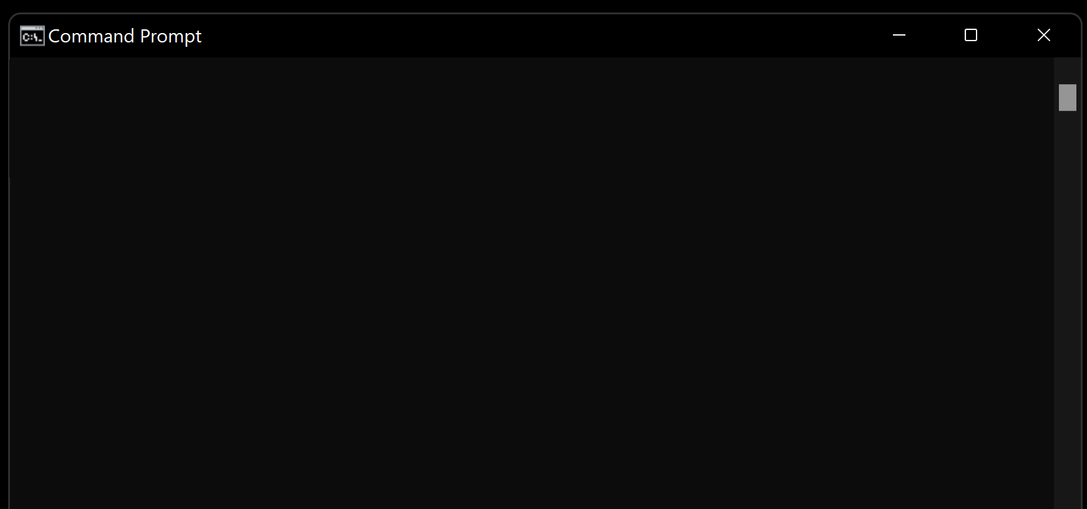
Modules – CommonJS
// index.js
var input = process.argv[2];
function beautify(text) {
return "«›-¤•.„.·´" + text + "`·.„.•¤­‹»";
}
// ...
console.log(beautify(input));
C:\Users\Kuba\Desktop\Sims 2 Infinite Money>node index.js KUBA94
«›-¤•.„.·´KUBA94`·.„.•¤­‹»
C:\Users\Kuba\Desktop\Sims 2 Infinite Money>

Slide 34
Modules – CommonJS
// index.js
var input = process.argv[2];
// ...
console.log(beautify(input));
// beautifyModule.js
var fileModule = (function () {
function beautify(text) {
return "«›-¤•.„.·´" + text + "`·.„.•¤­‹»";
}
return { beautify };
})();
<script>
🤔
C:\Users\Kuba\Desktop\Sims 2 Infinite Money>node index.js KUBA94
«›-¤•.„.·´KUBA94`·.„.•¤­‹»
C:\Users\Kuba\Desktop\Sims 2 Infinite Money>

Slide 35
Modules – CommonJS
// index.js
var input = process.argv[2];
// ...
console.log(beautify(input));
// beautifyModule.js
var fileModule = (function () {
var module = {};
function beautify(text) {
return "«›-¤•.„.·´" + text + "`·.„.•¤­‹»";
}
return { beautify };
})();
🤔
C:\Users\Kuba\Desktop\Sims 2 Infinite Money>node index.js KUBA94
«›-¤•.„.·´KUBA94`·.„.•¤­‹»
C:\Users\Kuba\Desktop\Sims 2 Infinite Money>

Slide 36
Modules – CommonJS
// index.js
var input = process.argv[2];
// ...
console.log(beautify(input));
// beautifyModule.js
var fileModule = (function () {
var module = {};
function beautify(text) {
return "«›-¤•.„.·´" + text + "`·.„.•¤­‹»";
}
module.exports = { beautify };
return module;
})();
🤔
C:\Users\Kuba\Desktop\Sims 2 Infinite Money>node index.js KUBA94
«›-¤•.„.·´KUBA94`·.„.•¤­‹»
C:\Users\Kuba\Desktop\Sims 2 Infinite Money>

Slide 37
Modules – CommonJS
// index.js
var input = process.argv[2];
// ...
console.log(beautify(input));
// beautifyModule.js
function beautify(text) {
return "«›-¤•.„.·´" + text + "`·.„.•¤­‹»";
}
module.exports = { beautify };
🤔
C:\Users\Kuba\Desktop\Sims 2 Infinite Money>node index.js KUBA94
«›-¤•.„.·´KUBA94`·.„.•¤­‹»
C:\Users\Kuba\Desktop\Sims 2 Infinite Money>

Slide 38

Modules – CommonJS
// index.js
var input = process.argv[2];
// ...
var { beautify } = require("./beautifyModule.js");
console.log(beautify(input));
// beautifyModule.js
function beautify(text) {
return "«›-¤•.„.·´" + text + "`·.„.•¤­‹»";
}
module.exports = { beautify };
C:\Users\Kuba\Desktop\Sims 2 Infinite Money>node index.js KUBA94
«›-¤•.„.·´KUBA94`·.„.•¤­‹»
C:\Users\Kuba\Desktop\Sims 2 Infinite Money>

Slide 39
Modules – AMD
Asynchronous Module Definition
Problemy CommonJS:
synchroniczność
nodejs exclusive
require(`module-${version}.js`);
Rozwiązania:
requirejs?
ECMA…?
// scripts/util.js
define(["math"], function (math) {
return function (a, b) {
math.sqrt(math.pow(2, a) + math.pow(2, b));
};
});
// scripts/main.js
require(["util"], function (util) {
console.log(util(3, 4)); // 5
});
<script data-main="scripts/main" src="scripts/require.js"></script>

Slide 40
Modules – ESM
// module.js
export const value = "hello";
const API_KEY = "zaCELgL.0imfnc8mVLWwsAawjYr4Rx-Af50DDqtlx";
export default API_KEY.slice(0,5);
// module-consumer.js
import { value } from "./module.js";
console.log(value); // hello
import { value as moduleValue } from "./module.js";
console.log(moduleValue); // hello
import defaultImport from "./module.js";
console.log(defaultImport); // zaCEL
import * as everything from "./module.js";
console.log(everything); // { default: 'zaCEL', value: 'hello' }

Slide 41
Modules – ESM
// poor-pi.js
export const PI = 5
// calculator.js
import { PI } from "./poor-pi.js";
const oko = 21;
console.log(PI * oko);
<!-- index.html -->
<!DOCTYPE html>
<html lang="en">
<head>
<script type="module">
import { PI } from "./poor-pi.js";
document.getElementById("PI").innerHTML = PI;
</script>
</head>
<body>
<p>pi is <span id="PI"></span></p>
</body>
</html>

Slide 42
Modules – ESM
// poor-pi.js
export const PI = 5
// calculator.js
import { PI } from "./poor-pi.js";
const oko = 21;
console.log(PI * oko);
<!-- index.html -->
<!DOCTYPE html>
<html lang="en">
<head>
<script type="module">
import { PI } from "./poor-pi.js";
document.getElementById("PI").innerHTML = PI;
</script>
<script src="calculator.js" type="module"></script>
</head>
<body>
<p>pi is <span id="PI"></span></p>
</body>
</html>
import { beautify } from "./beautify.mjs";
var math = require("./math.cjs");
C:\dev>node calculator.js
105
C:\dev>
😖
// package.json
{
"type": "module"
}
🎉🥳
<script type="module"></script>

Slide 43
this
// Program.cs
var dog = new Animal("woof");
dog.Speak(); // woof
# main.py
dog = Animal("woof")
dog.speak() # woof
// Animal.cs
public class Animal
{
private string voice;
public Animal(string voice)
{
this.voice = voice;
}
public void Speak()
{
Console.WriteLine(this.voice);
}
}
# animal.py
class Animal:
def __init__(self, voice):
self.voice = voice
def speak(self):
print(self.voice)

Slide 44
this
// index.js
var dog = Animal("woof");
dog.speak(); // woof
# main.py
dog = Animal("woof")
dog.speak() # woof
// animal.js
function Animal(voice) {
return { };
}
# animal.py
class Animal:
def __init__(self, voice):
self.voice = voice
def speak(self):
print(self.voice)

Slide 45
this
// index.js
var dog = Animal("woof");
dog.speak(); // woof
# main.py
dog = Animal("woof")
dog.speak() # woof
// animal.js
function Animal(voice) {
return { speak };
}
# animal.py
class Animal:
def __init__(self, voice):
self.voice = voice
def speak(self):
print(self.voice)
function speak() {
console.log(voice);
}

Slide 46
this
// index.js
var dog = Animal("woof");
dog.speak(); // voice is not defined
# main.py
dog = Animal("woof")
dog.speak() # woof
// animal.js
function Animal(voice) {
return { speak };
}
function speak() {
console.log(voice);
}
# animal.py
class Animal:
def __init__(self, voice):
self.voice = voice
def speak(self):
print(self.voice)

Slide 47
this
// index.js
var dog = Animal("woof");
dog.speak(); // undefined
# main.py
dog = Animal("woof")
dog.speak() # woof
// animal.js
function speak() {
console.log(this.voice);
}
function Animal(voice) {
return { speak };
}
# animal.py
class Animal:
def __init__(self, voice):
self.voice = voice
def speak(self):
print(self.voice)

Slide 48
this
// index.js
var dog = Animal("woof");
dog.speak(); // woof
# main.py
dog = Animal("woof")
dog.speak() # woof
// animal.js
function speak() {
console.log(this.voice);
}
function Animal(voice) {
return { speak, voice };
}
# animal.py
class Animal:
def __init__(self, voice):
self.voice = voice
def speak(self):
print(self.voice)

Slide 49
this
// index.js
var dog = Animal("woof");
dog.speak(); // woof
# main.py
dog = Animal("woof")
dog.speak() # woof
// animal.js
function speak() {
console.log(this.voice);
}
function Animal(voice) {
var self = {};
self.speak = speak;
self.voice = voice;
return self;
}
# animal.py
class Animal:
def __init__(self, voice):
self.voice = voice
def speak(self):
print(self.voice)

Slide 50
this
// index.js
var dog = Animal("woof");
dog.speak(); // woof
# main.py
dog = Animal("woof")
dog.speak() # woof
// animal.js
function speak() {
console.log(this.voice);
}
function Animal(voice) {
this.speak = speak;
this.voice = voice;
return this;
}
# animal.py
class Animal:
def __init__(self, voice):
self.voice = voice
def speak(self):
print(self.voice)

Slide 51
this
// index.js
var dog = new Animal("woof");
dog.speak(); // woof
# main.py
dog = Animal("woof")
dog.speak() # woof
// animal.js
function speak() {
console.log(this.voice);
}
function Animal(voice) {
this.speak = speak;
this.voice = voice;
}
# animal.py
class Animal:
def __init__(self, voice):
self.voice = voice
def speak(self):
print(self.voice)

Slide 52
this
function logText() {
console.log(this.text);
}
logText(); // undefined
var a = { text: "AAA", logText };
a.logText(); // AAA
var b = { text: "BBB" };
logText.call(b); // BBB
var c = { text: "CCC" };
var bound = logText.bind(c);
bound(); // CCC

Slide 53
Dziedziczenie Prototypowe
Dziedziczenie
Kopiowanie struktury
“Też tak umiem”
Delegowanie
Nadanie pełnomocnictwa
“Kolega umie”
Prototyp
Szablon, wzór
Referencja
Adres kolegi

Slide 54
(delegowanie referencyjne)
Dziedziczenie Prototypowe
Dziedziczenie
Kopiowanie struktury
“Też tak umiem”
Delegowanie
Nadanie pełnomocnictwa
“Kolega umie”
Prototyp
Szablon, wzór
Referencja
Adres kolegi

Slide 55
(delegowanie referencyjne)
Dziedziczenie Prototypowe:
__proto__
var obj = {
a: "a",
b: "b",
__proto__:
}
console.log(obj.a); // a
console.log(obj.b); // b
console.log(obj.c); // proto c
{
b: "proto b",
}
c: "proto c"

Slide 56
(delegowanie referencyjne)
Dziedziczenie Prototypowe:
__proto__
var obj = {
a: "a",
b: "b",
__proto__: base
}
console.log(obj.a); // a
console.log(obj.b); // b
console.log(obj.c); // proto c
var obj2 = {
__proto__ : base
}
console.log(obj2.a); // undefined
console.log(obj2.b); // proto b
console.log(obj2.c); // proto c
var base =
{
b: "proto b",
}
c: "proto c"

Slide 57
(delegowanie referencyjne)
Dziedziczenie Prototypowe:
__proto__
var basebase = {
}
var base = {
b: "proto b",
__proto__: basebase
}
c: "proto c"
var obj = {
a: "a",
b: "b",
__proto__: base
}
console.log(obj.a); // a
console.log(obj.b); // b
console.log(obj.c); // proto c
var obj2 = {
__proto__ : base
}
console.log(obj2.a); // undefined
console.log(obj2.b); // proto b
console.log(obj2.c); // proto c

Slide 58
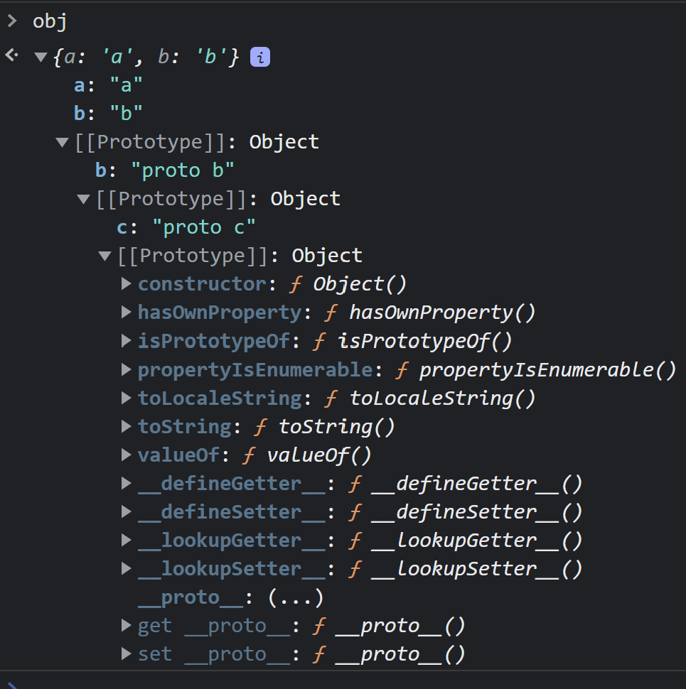
(delegowanie referencyjne)
Dziedziczenie Prototypowe:
__proto__
var obj = {
a: "a",
b: "b",
__proto__: {
b: "proto b",
__proto__: {
c: "proto c"
}
}
}

Slide 59
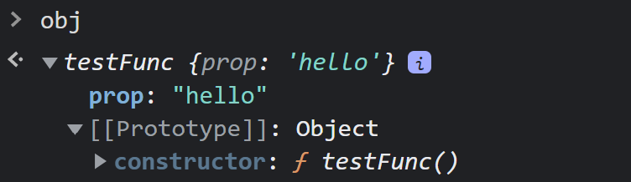
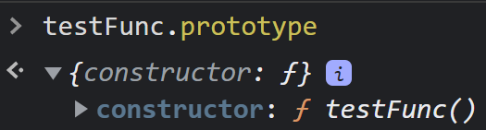
(delegowanie referencyjne)
Dziedziczenie Prototypowe: constructor
function testFunc() {
this.prop = "hello";
console.log("hello from testFunc()");
}
var obj = new testFunc(); // hello from testFunc()
obj.constructor(); // hello from testFunc()
obj.__proto__.constructor(); // hello from testFunc()
obj.__proto__ === testFunc.prototype; // true
var obj1 = new testFunc();
var obj2 = new testFunc();
obj1.__proto__ === obj2.__proto__; // true

Slide 60
(delegowanie referencyjne)
Dziedziczenie Prototypowe: prototype
// index.js
var dog = new Animal("woof");
dog.speak(); // woof
# main.py
dog = Animal("woof")
dog.speak() # woof
// animal.js
function Animal(voice) {
this.voice = voice;
this.speak = speak;
}
function speak() {
console.log(this.voice);
}
# animal.py
class Animal:
def __init__(self, voice):
self.voice = voice
def speak(self):
print(self.voice)

Slide 61
(delegowanie referencyjne)
Dziedziczenie Prototypowe: prototype
// index.js
var dog = new Animal("woof");
dog.speak(); // woof
# main.py
dog = Animal("woof")
dog.speak() # woof
// animal.js
function Animal(voice) {
this.voice = voice;
}
Animal.prototype.speak = speak;
function speak() {
console.log(this.voice);
}
# animal.py
class Animal:
def __init__(self, voice):
self.voice = voice
def speak(self):
print(self.voice)

Slide 62
(delegowanie referencyjne)
Dziedziczenie Prototypowe: prototype
// index.js
var dog = new Animal("woof");
dog.speak(); // woof
# main.py
dog = Animal("woof")
dog.speak() # woof
// animal.js
function Animal(voice) {
this.voice = voice;
}
Animal.prototype.speak = function () {
console.log(this.voice);
}
# animal.py
class Animal:
def __init__(self, voice):
self.voice = voice
def speak(self):
print(self.voice)

Slide 63
(delegowanie referencyjne)
Dziedziczenie Prototypowe: new
// index.js
var dog = new Animal("woof");
dog.speak(); // woof
// animal.js
function Animal(voice) {
this.voice = voice;
}
Animal.prototype.speak = function () {
console.log(this.voice);
}

Slide 64
(delegowanie referencyjne)
Dziedziczenie Prototypowe: new
// index.js
var dog = new Animal("woof");
dog.speak(); // woof
// index.js
var cat = _new(Animal, "meow");
cat.speak(); // meow
function _new(constructor, ...params) {
var self = {};
constructor.call(self, ...params);
self.__proto__ = constructor.prototype;
return self;
}
// animal.js
function Animal(voice) {
this.voice = voice;
}
Animal.prototype.speak = function () {
console.log(this.voice);
}

Slide 65
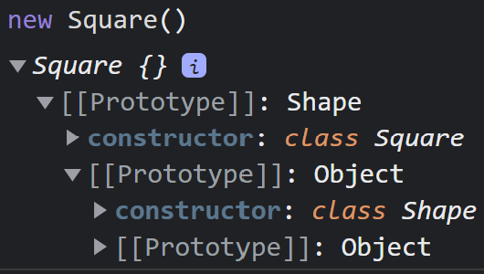
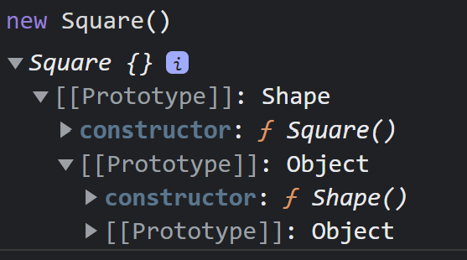
(delegowanie referencyjne)
Dziedziczenie Prototypowe: class
class Shape {}
class Square extends Shape {}
function Shape() {}
function Square() {}
Square.prototype.__proto__ = Shape.prototype;

Slide 66
🚗
Lexical scope
IIFE (Immediately invoked Function Expressions)
ES Module
“This” awareness
Prototypal Inheritance (Referential Delegation)
Class syntax sugar

Slide 67
Autostopem przez JavaScript
Poradnik dla Backendowców
kolezyn.ski/talks
Jakub Koleżyński

